Slide 1
Network Visualization
James Moody
Duke Network Analysis Center (DNAC)
https://dnac.ssri.duke.edu/
Duke University
https://tinyurl.com/SN-H2018
This work is supported by NIH grants DA12831 and HD41877. Thanks to Dan McFarland, Skye Bender-deMoll, Martina Morris, Lisa Keister, Scott Gest and Peter Mucha for discussion and comments related to this presentation. Please send any correspondence to James Moody, Department of Sociology, Duke University, Durham NC 27705. email: jmoody77@soc.duke.edu

Slide 2
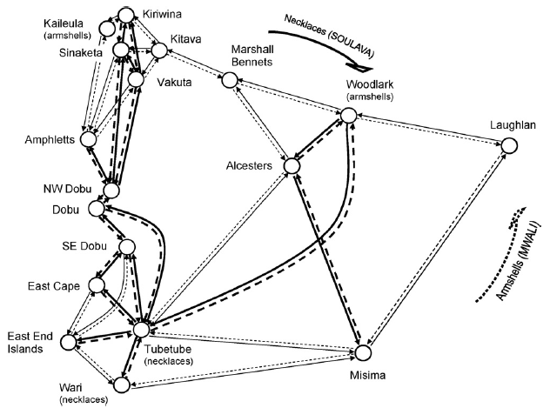
Introduction
From the beginning, network science has been a visual science, rich with strange images purporting to illuminate our understanding of the world.

Slide 3
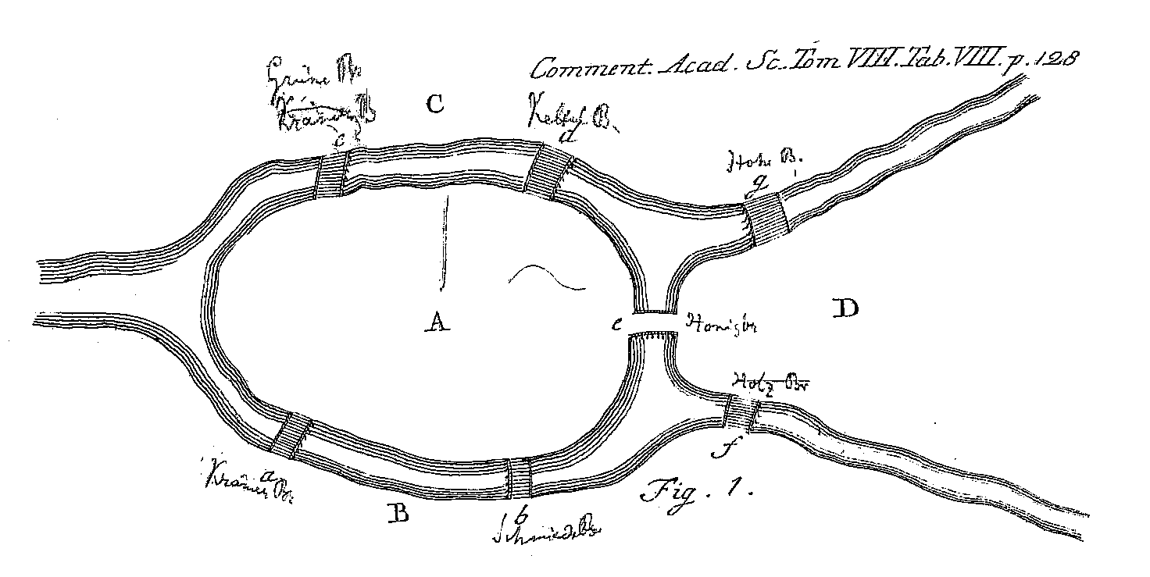
A Little network Visualization History
Promising Foundations
The study of networks has depended on a visual thinking since the beginning:
Euler, 1741
Euler’s treatment of the “Seven Bridges of Kronigsberg” problem is one of the first moments of graph theory, where he contrasted the observed map….
Notes:
This image is from the original publication in 1741. Though modern reproductions of his proof reduce this to the image of a graph,
His publication only shows a tabular listing. But the tables refer back to the map and depend on the bridge/land topology to work.

Slide 4
A Little network Visualization History
Promising Foundations
The study of networks has depended on a visual thinking since the beginning:
Euler, 1741
… to an alternative to help think through what would became the first theorem in graph theory, and the development of elements (land masses/vertices) linked as pairs (edges/bridges)
Notes:
This image is from the original publication in 1741. Though modern reproductions of his proof reduce this to the image of a graph,
His publication only shows a tabular listing. But the tables refer back to the map and depend on the bridge/land topology to work.

Slide 5
A Little network Visualization History
Promising Foundations
The study of networks has depended on a visual thinking since the beginning:
Euler, 1741
… and abstracted from the observed elements (land masses/bridges) to abstract connections (Vertices/edges)
Notes:
This image is from the original publication in 1741. Though modern reproductions of his proof reduce this to the image of a graph,
His publication only shows a tabular listing. But the tables refer back to the map and depend on the bridge/land topology to work.

Slide 6
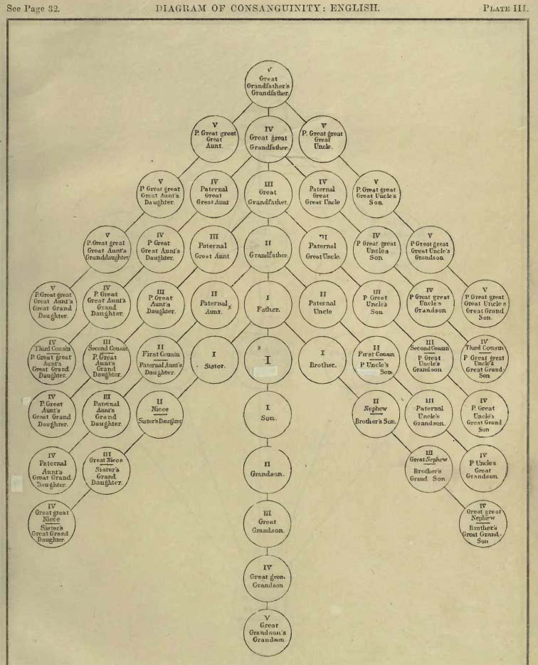
A Little network Visualization History
Promising Foundations
The study of networks has depended on a visual thinking since the beginning:
Early kinship diagrams by Morgan (1871)
Diagram of consanguinity: Seneca-Iroquois (lineal & 1st collateral lines, ego is male)
Notes:
This image is from the original publication in 1741. Though modern reproductions of his proof reduce this to the image of a graph,
His publication only shows a tabular listing. But the tables refer back to the map and depend on the bridge/land topology to work.

Slide 7
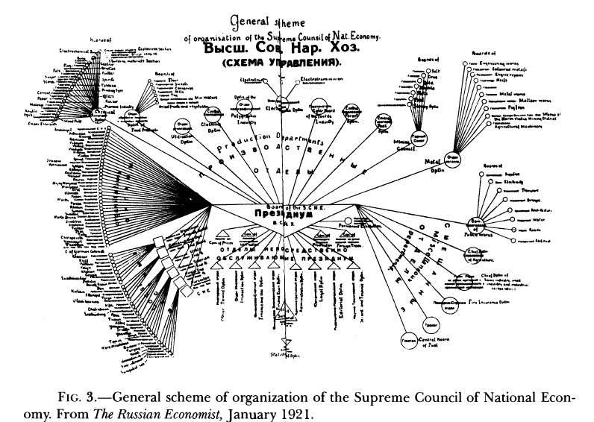
A Little network Visualization History
Promising Foundations
The study of networks has depended on a visual thinking since the beginning:
Or early representations of organizational relations (1921)
Notes:
This image is from the original publication in 1741. Though modern reproductions of his proof reduce this to the image of a graph,
His publication only shows a tabular listing. But the tables refer back to the map and depend on the bridge/land topology to work.

Slide 8
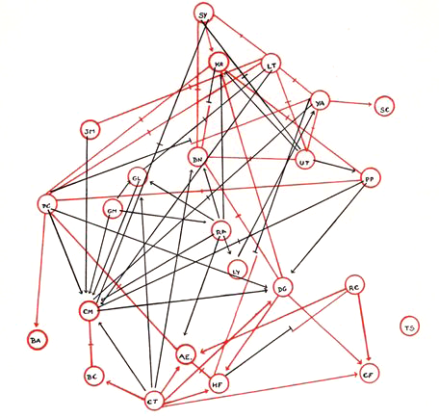
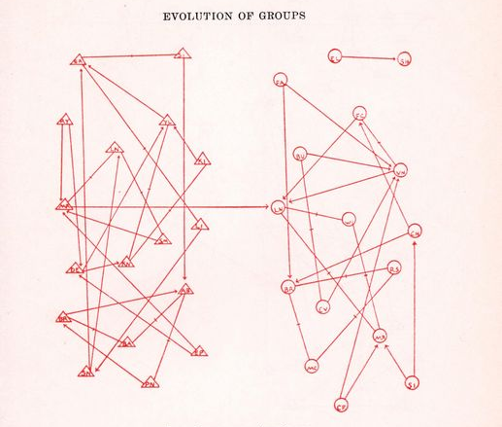
A Little network Visualization History
Promising Foundations
The study of networks has depended on a visual thinking since the beginning:
..but Moreno’s sociograms from Who Shall Survive (1934) were something special. They ignited a wave of research that was to fundamentally transform social science.
Notes:
Moreno claimed authorship of the idea; citing no real inspiration other than his own creativity. But graph theory has been going since 1740s, kinship diagrams since at least the 1870s, org charts from the 1920s, etc. So he’s not operating in a vacuum.

Slide 9
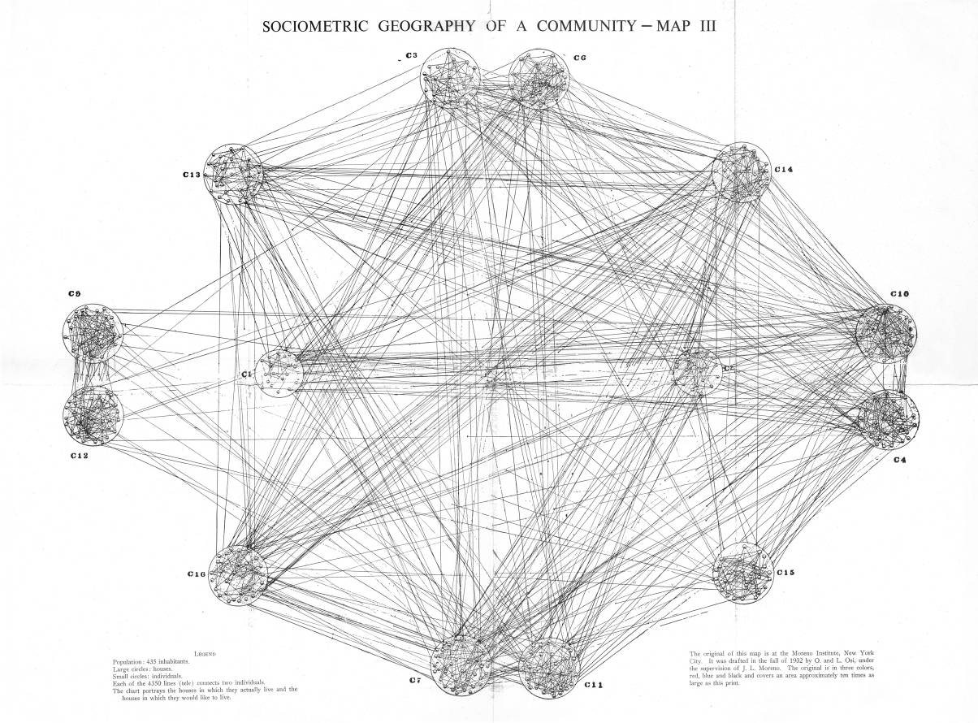
A Little network Visualization History
Promising Foundations
The study of networks has depended on a visual thinking since the beginning:
With a full write-up of the 1934 medical conference in the New York Times*, his work sparked wide interest….
*He claims it was covered in “all the major papers” but I can’t find any other clips…
Notes:
Moreno claimed authorship of the idea; citing no real inspiration other than his own creativity. But graph theory has been going since 1740s, kinship diagrams since at least the 1870s, org charts from the 1920s, etc. So he’s not operating in a vacuum.

Slide 10
A Little network Visualization History
Promising Foundations
Lundberg & Steel 1938 – Using a “Social Atom” representation
Moreno’s idea was quickly taken up in community studies, as the social analog to “atoms” in physics….

Slide 11
A Little network Visualization History
Promising Foundations
Charles Loomis – 1948
The sophistication included layering of information…here using size, position, and a pie-chart to tap multiple variables in addition to network structure.

Slide 12
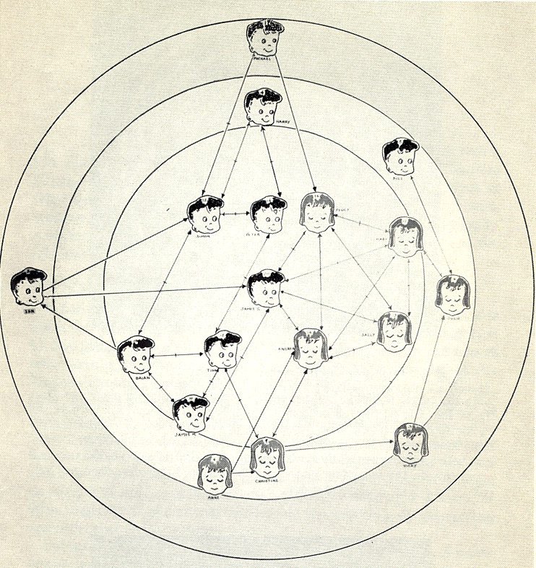
A Little network Visualization History
From Art to Science…
Northaway’s – “Target Sociograms”
Researchers increasingly sought ways move from artistic production to science -- The “target” sociogram was an early example.

Slide 13
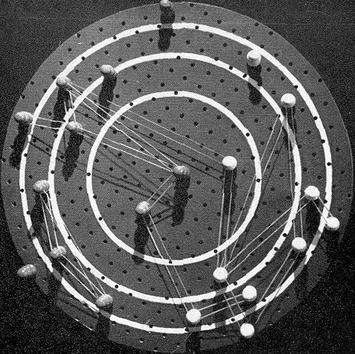
A Little network Visualization History
From Art to Science…
..complete with “hardware” to help in the construction!

Slide 14
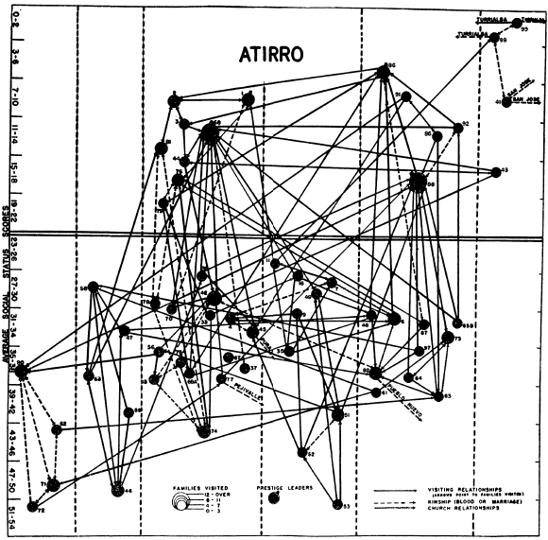
A Little network Visualization History
From Art to Science…
Another attempt at regularization: add meaning to the y and x axes (here social status and “group” respectively).
Loomis & McKinney, 1956, AJS
Attempts at generalizing dimensional meaning start to get muddy as the figures no longer carry an intuitive connectivity pattern.

Slide 15
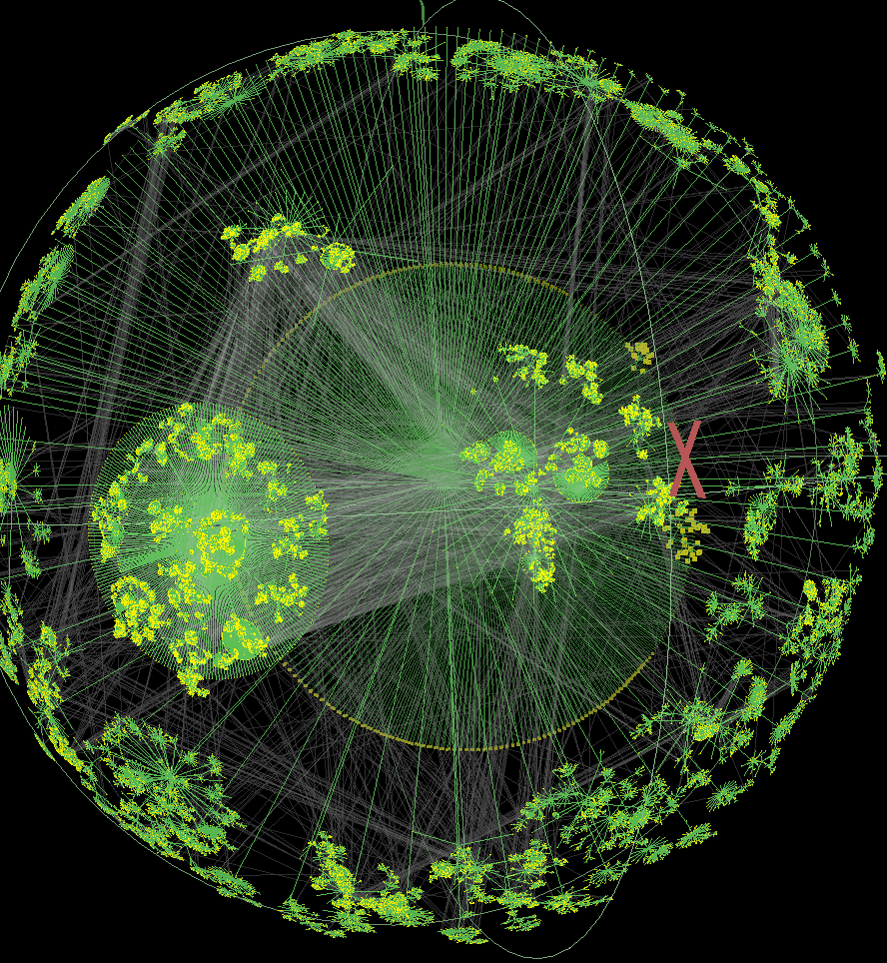
A Little network Visualization History
From Art to Science…
The space-bending challenge is made clear in modern attempts at mapping large-scale networks…
Walrus
(Tamara Munzer & Caida)
The flow of images continued over time, marking a wide range of potential styles.

Slide 16
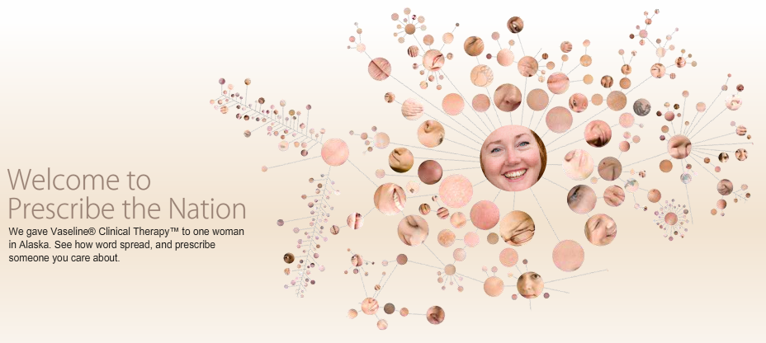
A Little network Visualization History
From Science to Silly…
Sadly, we are now starting to see caricatures of “network” images everywhere:

Slide 17
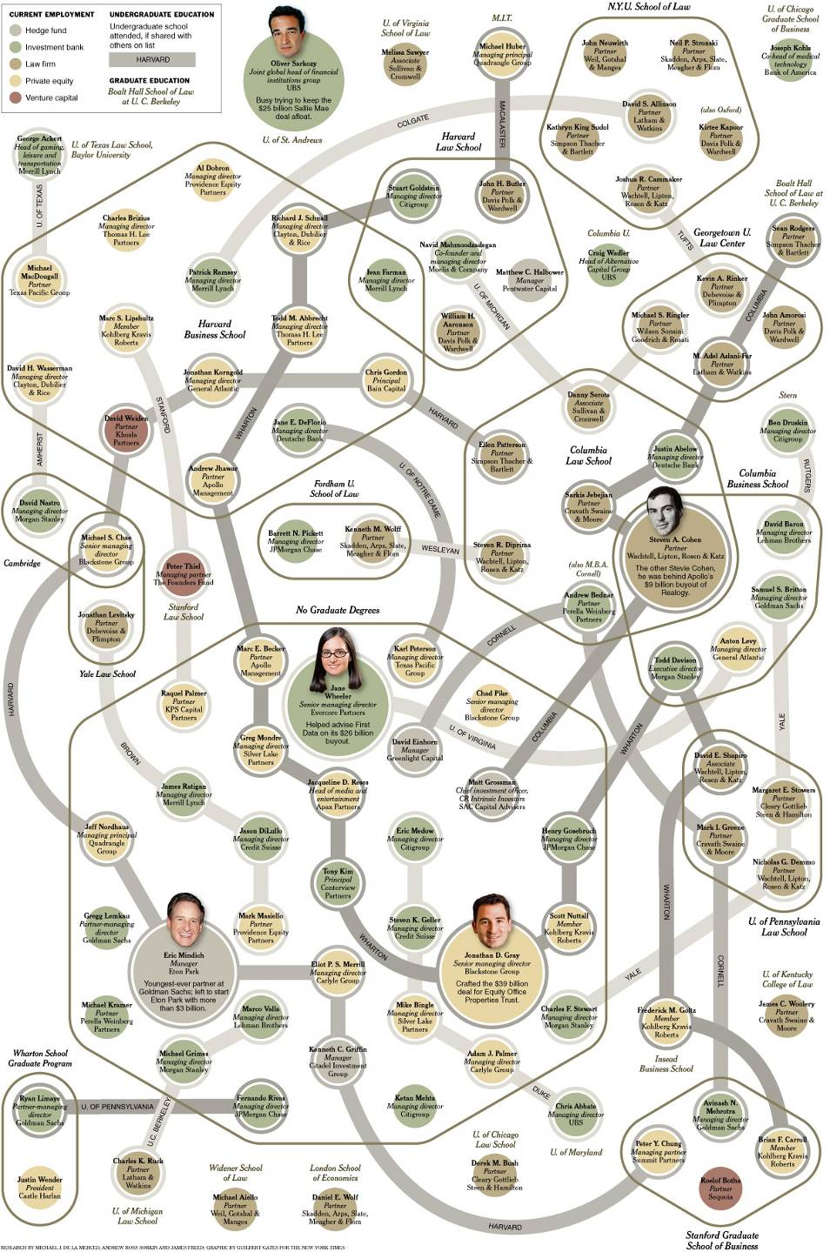
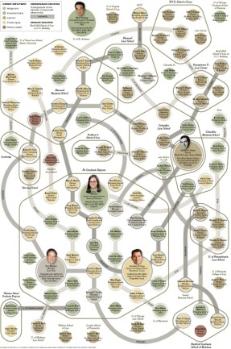
A Little network Visualization History
From Science to Silly…
A New York Times graphic on links between wall-street executives and the business school they attended…

Slide 18
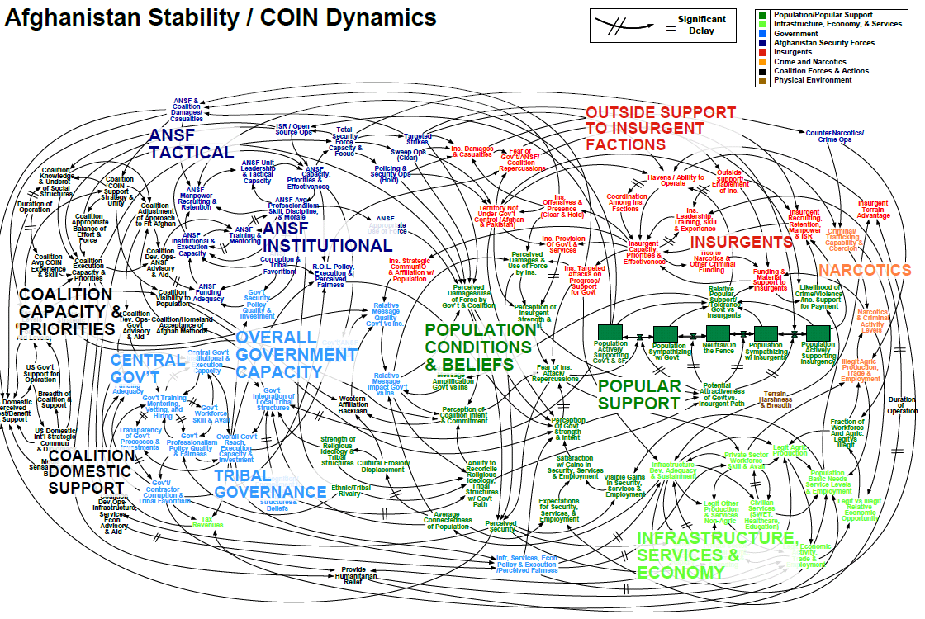
A Little network Visualization History
From Science to Silly…
From silly, to dangerous: the “causal model” network for the Afghan conflict

Slide 19
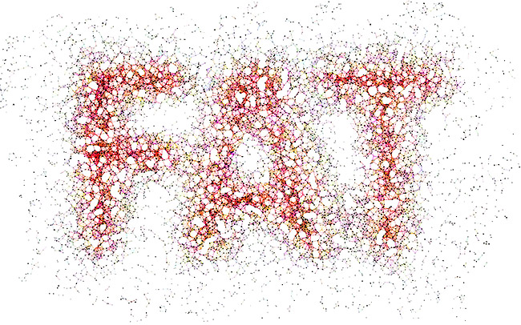
A Little network Visualization History
From Science to Silly…
…or downright spoofs of the real thing…

Slide 20
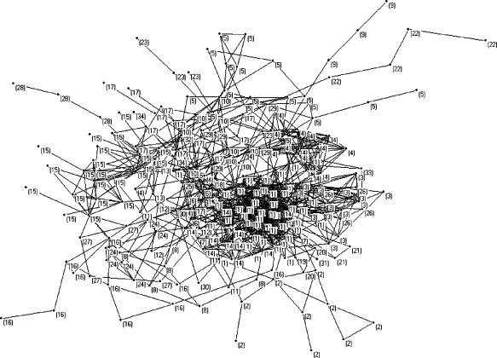
A Little network Visualization History
From Science to Silly…
Lest we think only journalist do things with marginal scientific / information value….many (most?) published network images are information thin.
Such images often provide extremely little information; and the information one can derive from the image is often wrongly-weighted.
Our challenge today is two-fold:
What is it about visual representations that seem so important to network studies?
How do we do it well?
Science, Art or Craft?

Slide 21
A Little network Visualization History
Lessons from history?
The historic reliance on imagery is clear in Moreno’s work:
"If we ever get to the point of charting a whole city or a whole nation, we would have … a picture of a vast solar system of intangible structures, powerfully influencing conduct, as gravitation does in space. Such an invisible structure underlies society and has its influence in determining the conduct of society as a whole."
J.L. Moreno, New York Times, April 13, 1933
We literally make the invisible visible. Part of the captivation of network science is the ability to see into a world that is otherwise extremely difficult to wrap our heads around.

Slide 22
Why Visualize Network at all?
Insights from scatter plots
While the history is deeply rooted in visual analysis, why bother? If we have good metrics, why not use them instead?
These 3 series seem very similar, when viewed statistically:
N=11
Mean of Y = 7.5
Regression Equation: Y = 3 + .5(X)
SE of slope estimate: 0.118, T=4.24
Sum of Squares (X-X): 110
Regression SS: 27.5
Correlation Coeff: 0.82
Notes:
Consider Anscombe’s answer in the 1973 American Statistician (replicated in Tufte)

Slide 23
Why Visualize Network at all?
Insights from scatter plots
While the history is deeply rooted in visual analysis, why bother? If we have good metrics, why not use them instead?
And given these statistics, we expect a relation something like this – a strong correlation with “random” error.

Slide 24
Why Visualize Network at all?
Insights from scatter plots
While the history is deeply rooted in visual analysis, why bother? If we have good metrics, why not use them instead?
..but this would also fit…

Slide 25
Why Visualize Network at all?
Insights from scatter plots
While the history is deeply rooted in visual analysis, why bother? If we have good metrics, why not use them instead?
…or this…
Or many more.

Slide 26
Why Visualize Network at all?
Insights from scatter plots
While the history is deeply rooted in visual analysis, why bother? If we have good metrics, why not use them instead?
Visualization allows you to see the relations among elements “in the whole” – a complete macro-vision of your data in ways that summary statistics cannot. This is largely because a good summary statistic captures a single dimension, while visualization allows us to layer dimensionality and relations among them.

Slide 27
Why Visualize Network at all?
Insights from scatter plots
But consider changing a key assumption of the scatter-plot: the scaled ordering of the axes.
15
15
14
14
13
13
Standard View
Permuted View
12
12
11
11
10
10
9
9
8
8
7
7
6
6
5
5
4
4
3
3
2
2
1
1
0
0
12
2
6
0
11
8
1
13
7
4
3
15
10
14
9
5
0
1
2
3
4
5
6
7
8
9
10
11
12
13
14
15
Technically, all the information is retained - one could reconstruct the data pairs from both images – but the re-ordered panel provides no additional information.

Slide 28
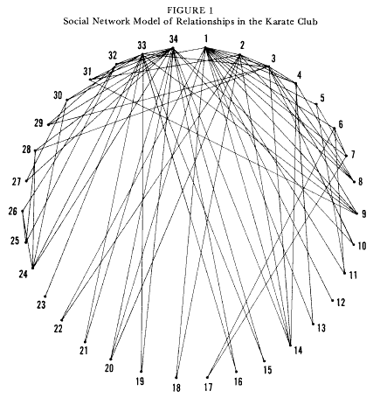
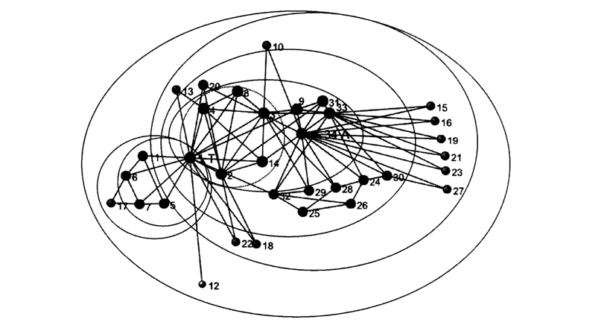
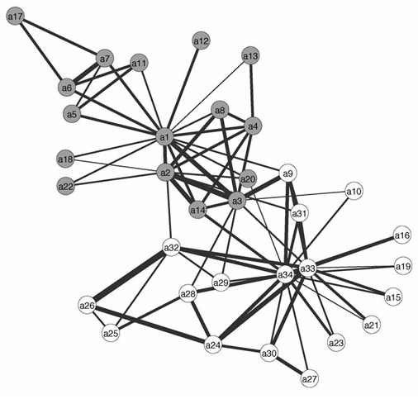
Why Visualize Network at all?
Insights from scatter plots
3 representations of the same data
Original
White & Harary, 2001
Kolaczyk, Eric D., Chua, David B., Barthélemy, Marc (2009)
The exact same data, presented in press in distinct ways. We’d never see this with a scatter plot.
Notes:
Note this sort of variablity has lead to substantive errors, as people try to transcribe nets from published images. See J.L. Martin 2009, Chapter 1.

Slide 29
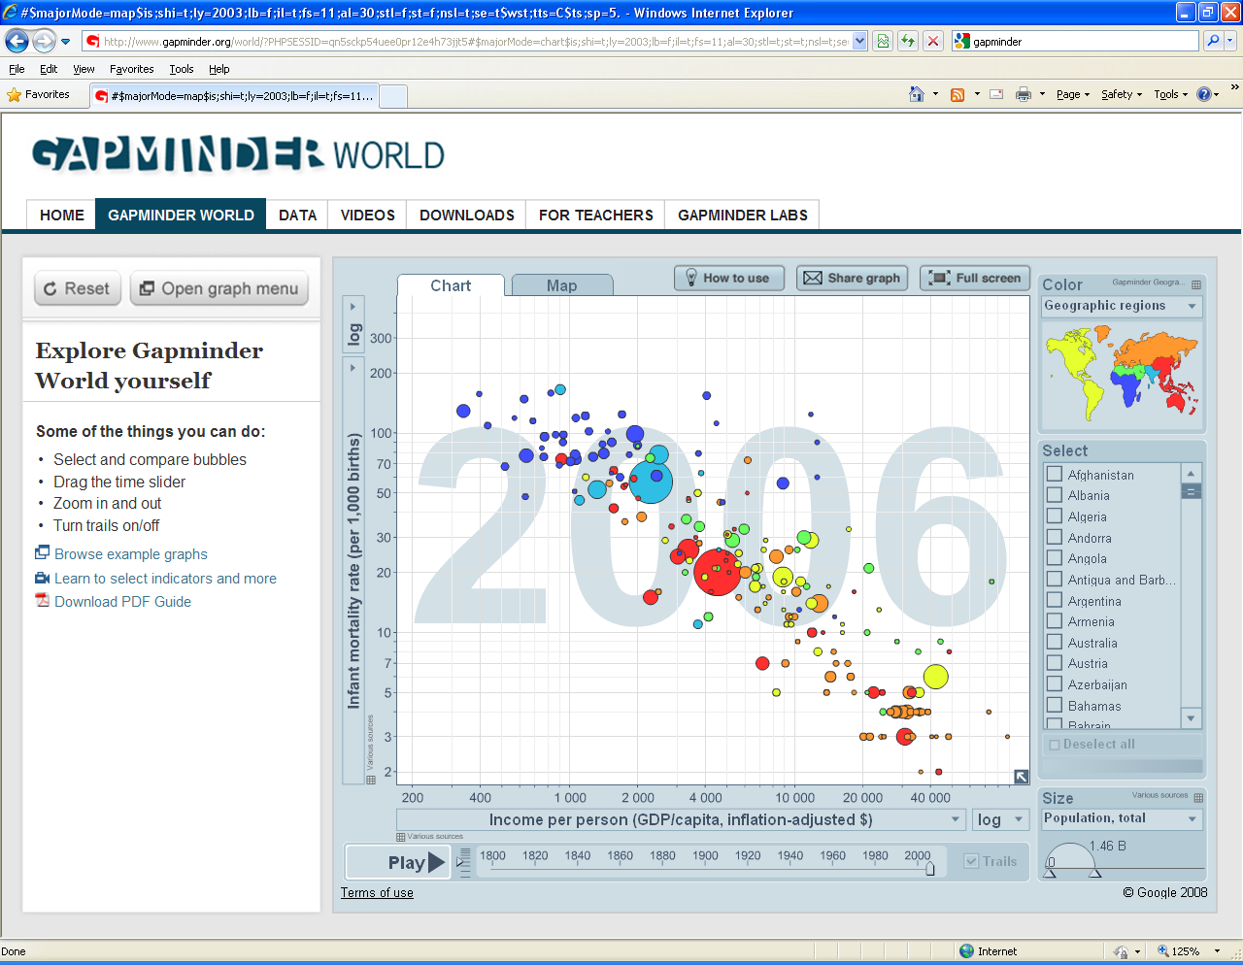
Why Visualize Network at all?
Insights from scatter plots
Scatter plots are good models for network imagery:
Multiple dimensions
Layered information
Global patterns with local detail
Shape matters
Fails as a model in a key respect: The coordinate space is rigid.
The reason to visualize is that we discover elements we didn’t already know, and can communicate it effectively.
Gapminder
Notes:
Note this sort of variablity has lead to substantive errors, as people try to transcribe nets from published images. See J.L. Martin 2009, Chapter 1.

Slide 30
Benefits to network graphics
Make visible the invisible
Give a sense of reality to unobserved features
Can be truly beautiful (when well done), capturing audience imaginations
Can communicate complex features quickly
Provide multi-dimensional insights into setting processes
Metrics capture a single dimension
We care about the shape of related entities
Help us contextualize and make sense of the metrics we calculate
Help us think by organizing, arranging and abstracting generals from particulars
Networks are already massive abstractions – removing qualitative micro-detail to capture interconnectivity
..but we often need to abstract further to identify elements we care about.
Why Visualize Network at all?
Problem summary
Notes:
The art analogy I have in mind is the contrast of, say, painting to music – music is creative within levels of constraint – defined by key, time signature, rule of harmony, etc. These can be violated, but the ability to pull that off is a skill – bad violations of harmony rules are amiturish, good ones are the mark of creativity.
The 3 featuers are actually 4, since “spread” and “space” are distinct.

Slide 31
Communication Challenges in Network Visualization
Types of problems
Why are network visualizations difficult? Too much information
Network Specific graphic problems:
Model for social space
Resolution (local or global)
Multiple relations
Dynamics
Density
Node-level attributes
Edge-level attributes
Hierarchical ordering
Diffusion Potential
Exploration or communication
Visualization
Strategy
Data
Fidelity
Knowledge
problem
There is a set of basic tradeoffs made with every visualization between data, the research problem, and the final image, which can challenge our basic instincts as scientists, since we may have to make stuff up or throw away data.

Slide 32
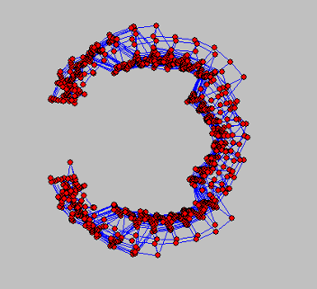
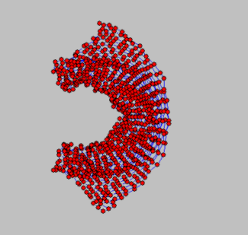
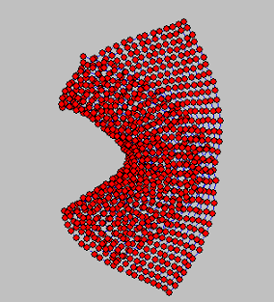
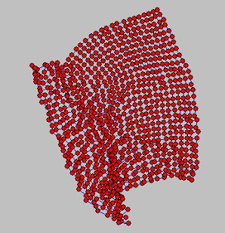
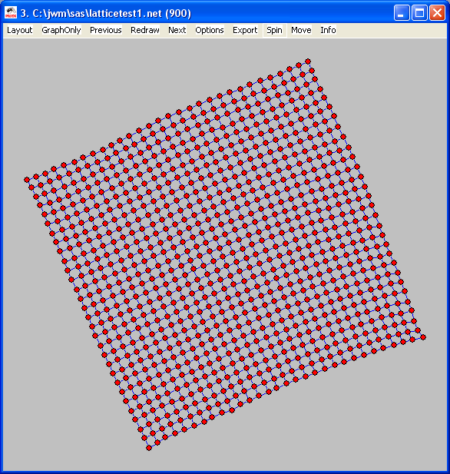
What makes a good visualization?
Solutions
These problems feed an entire field of graph-visualization heuristics; guides to tell computers how “best” to arrange points, which focus on:
Even node distribution
Consistent edge lengths
Avoid line crossing
Emphasize symmetry
Maximize edge-edge angles
Avoid lines passing over nodes
Avoid node overlaps
And many many more…
Auto layouts have two conflicting problems to solve:
(a) finding a good layout and
(b) finding it quickly.
Notes:
The art analogy I have in mind is the contrast of, say, painting to music – music is creative within levels of constraint – defined by key, time signature, rule of harmony, etc. These can be violated, but the ability to pull that off is a skill – bad violations of harmony rules are amiturish, good ones are the mark of creativity.
The 3 featuers are actually 4, since “spread” and “space” are distinct.

Slide 33
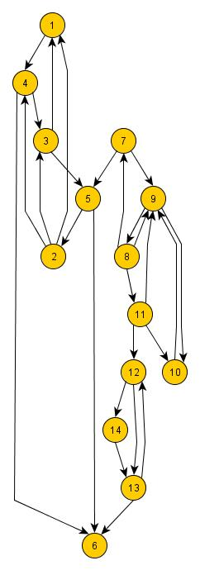
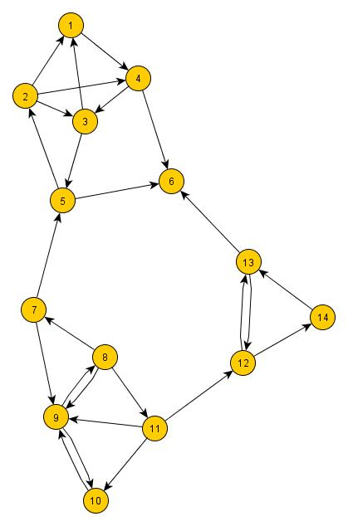
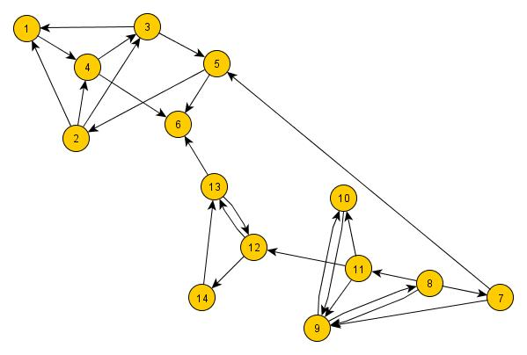
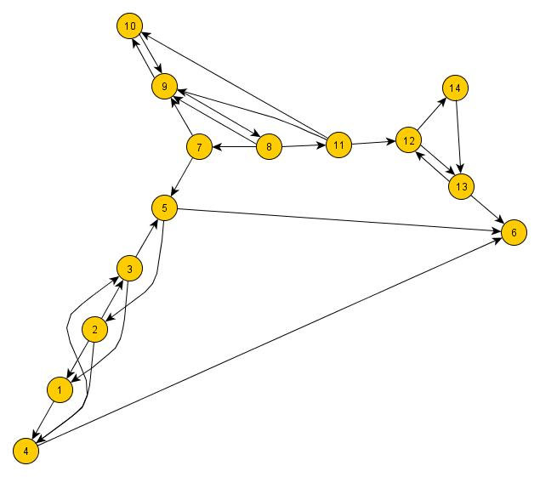
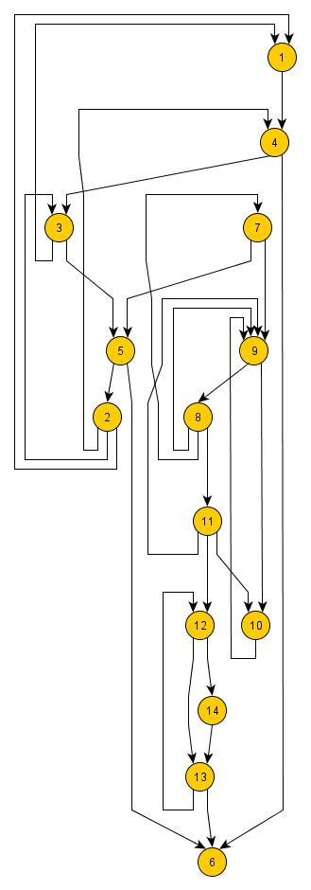
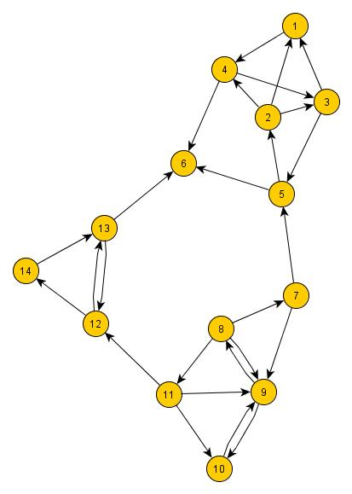
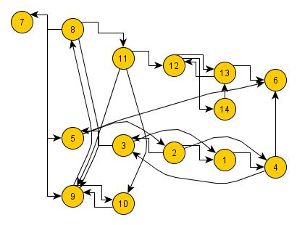
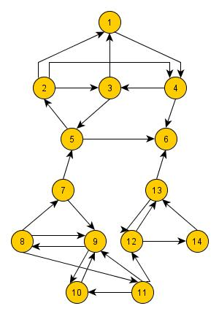
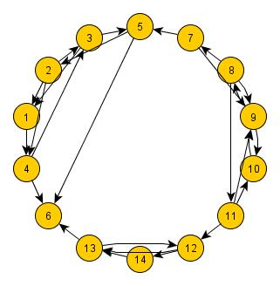
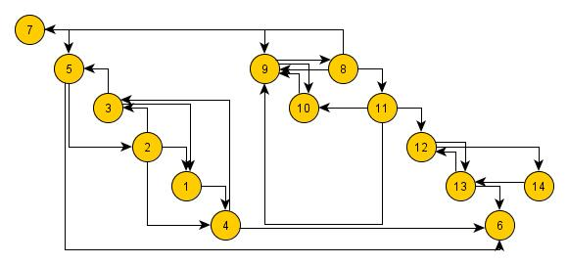
What makes a good visualization?
Unlike a scatter-plot, the default layout styles of most off-the-shelf programs will lead to very different layouts:

Slide 34
What makes a good (data) visualization?
The simplest answer is that an image should clearly communicate something that we would have difficulty knowing any other way:
This includes:
Information & Communication:
Helping build intuition about the social process generating the network
Succinctly capturing high-dimensional properties of the network
Being worth the space– the information content of the image needs to reward deeper inspection
Beauty – powerful graphs are mesmerizing
Notes:
The art analogy I have in mind is the contrast of, say, painting to music – music is creative within levels of constraint – defined by key, time signature, rule of harmony, etc. These can be violated, but the ability to pull that off is a skill – bad violations of harmony rules are amiturish, good ones are the mark of creativity.
The 3 featuers are actually 4, since “spread” and “space” are distinct.

Slide 35
What makes a good (scientific) visualization?
The simplest answer is that an image should clearly communicate something that we would have difficulty knowing any other way:
This includes:
Science:
Ability to replicate results – same data should produce same picture
Quantification – most features evident from a graph should be translatable to a measurement of the graph (though this may not be initially evident)
Theory-relevant: either gives us something new to theorize about or is useful as a theory-building device itself.
This probably implies a move toward problem-specific families of visualizations.
Notes:
The art analogy I have in mind is the contrast of, say, painting to music – music is creative within levels of constraint – defined by key, time signature, rule of harmony, etc. These can be violated, but the ability to pull that off is a skill – bad violations of harmony rules are amiturish, good ones are the mark of creativity.
The 3 featuers are actually 4, since “spread” and “space” are distinct.

Slide 36
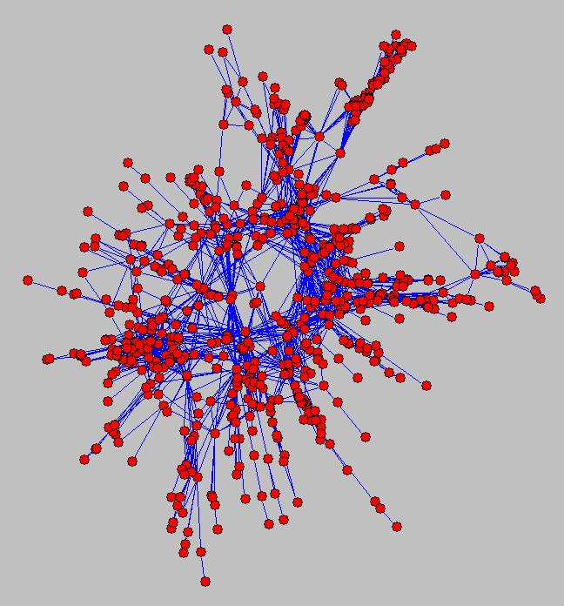
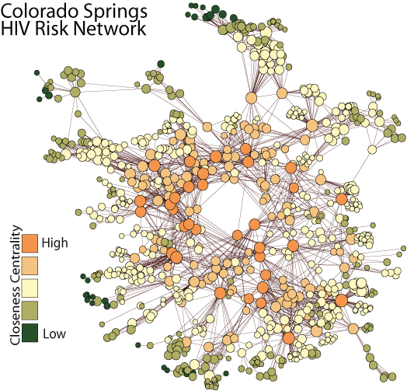
Communication Challenges in Network Visualization
Types of problems
So what distinguishes a scientifically effective visualization?
Basic quantitative visualization craft: (“style” or “rhetoric”)
Before
After

Slide 37
What makes a good visualization?
Unlike a scatter-plot, the default layout styles of most off-the-shelf programs will lead to very different layouts:
Visualization
Strategy
Data
Fidelity
Knowledge
problem
Visualization as craft: My instinct is that hard-and-fast rules will be difficult to find, craft production is thus a better model than either art (too expressive) or technical drawing (too rigid).
Let’s work through some exemplars and see how they balanced these trades

Slide 38
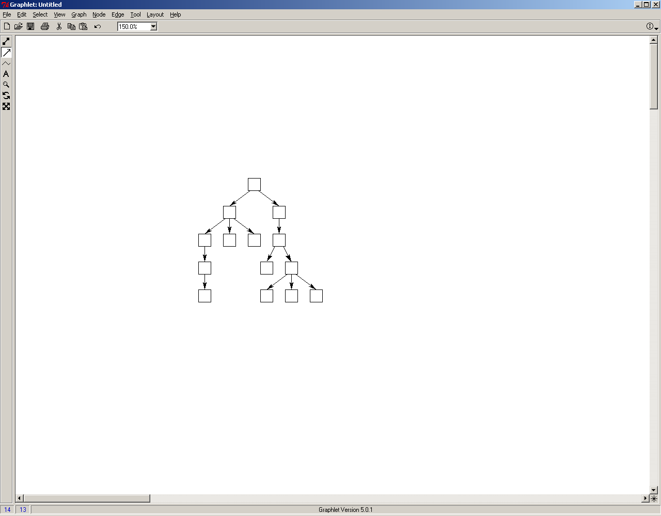
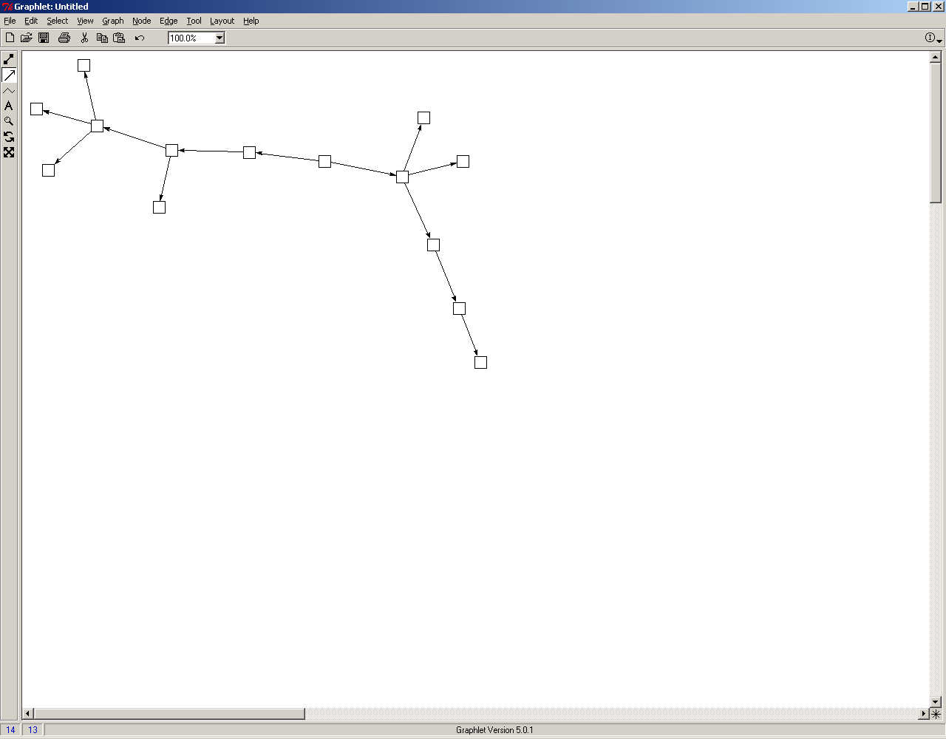
Basic Layout Heuristics
Network visualization helps build intuition, but you have to keep the drawing heuristic. Here we show the same graphs with two different techniques:
Tree-Based layouts
“Force” layouts
(good)
(Fair - poor)
Most effective for very sparse, regular graphs. Very useful when relations are strongly directed, such as organization charts, cluster tress or internet connections.
Most effective with graphs that have a strong community structure (clustering, etc). Provides a very clear correspondence between social distance and plotted distance
Two images of the same network

Slide 39
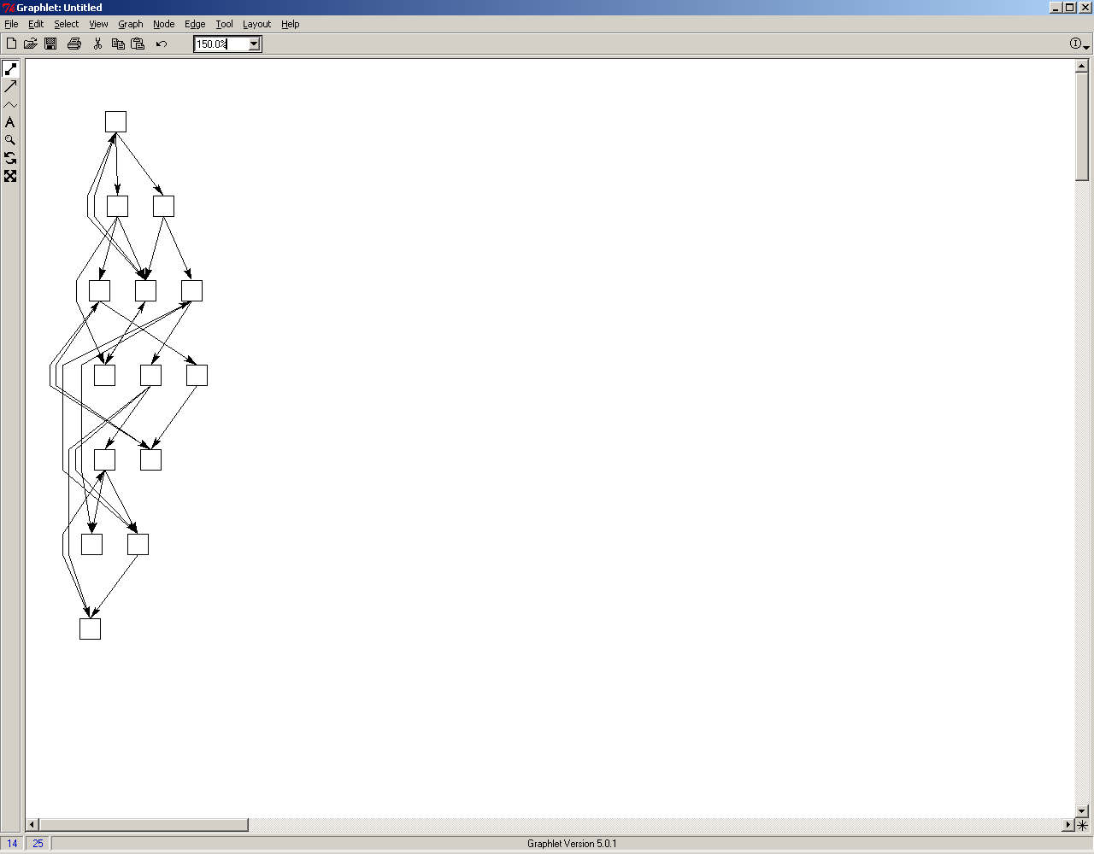
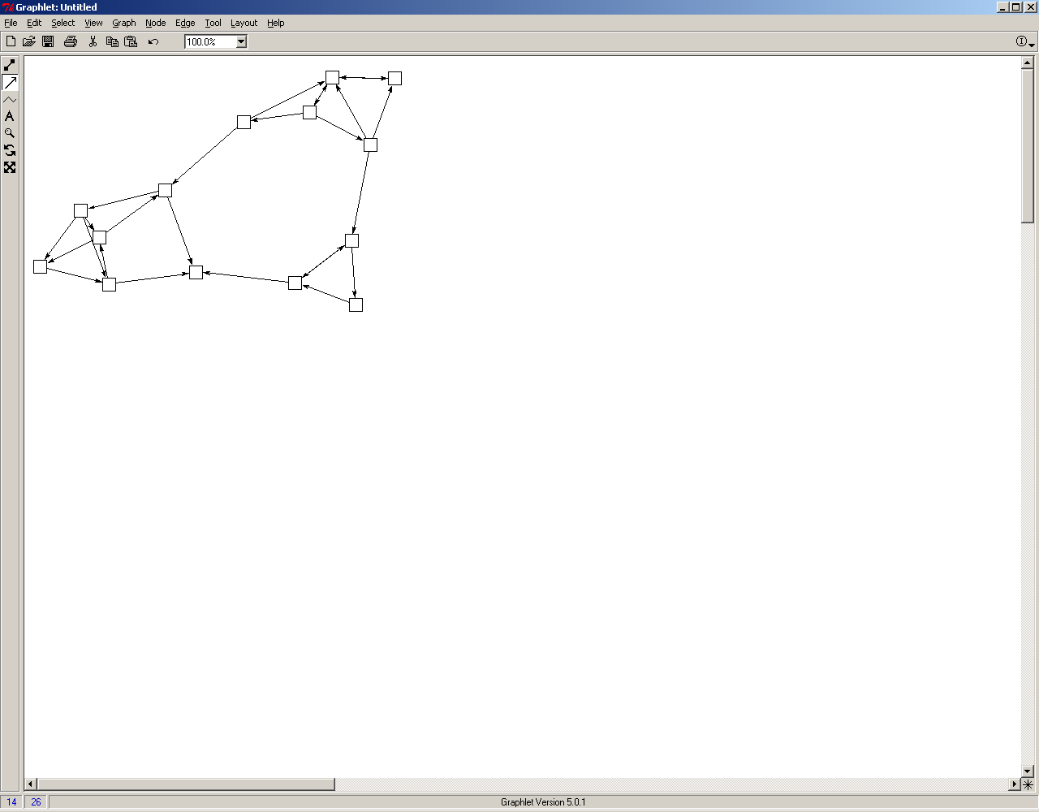
Basic Layout Heuristics
Network visualization helps build intuition, but you have to keep the drawing heuristic. Here we show the same graphs with two different techniques:
Tree-Based layouts
Spring embedder layouts
(poor)
(good)
“good” = high correlation between spatial distance and network distance
Two layouts of the same network

Slide 40
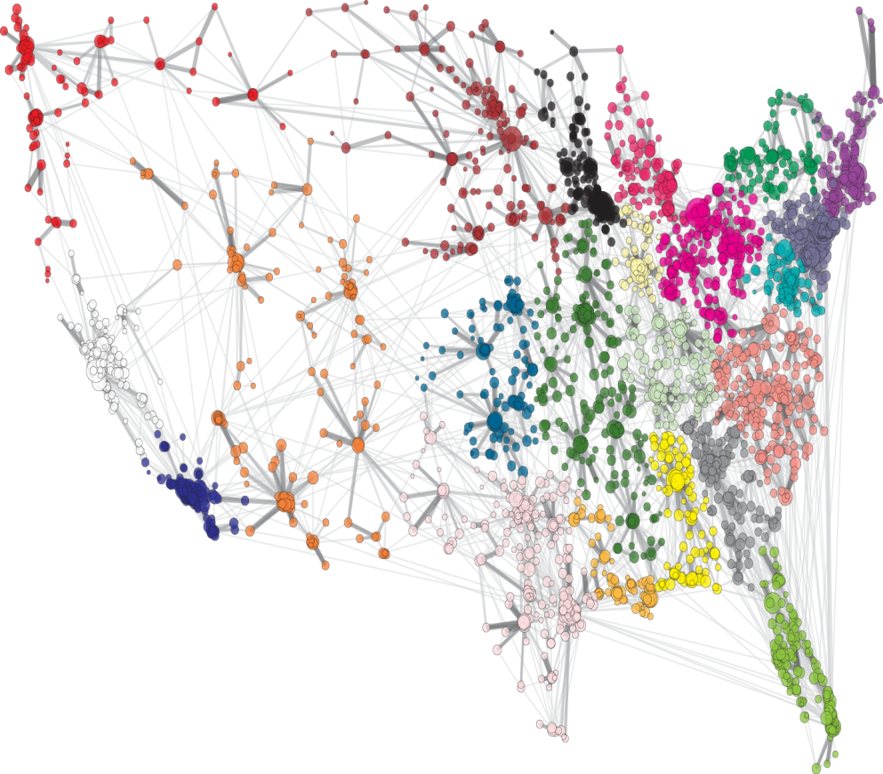
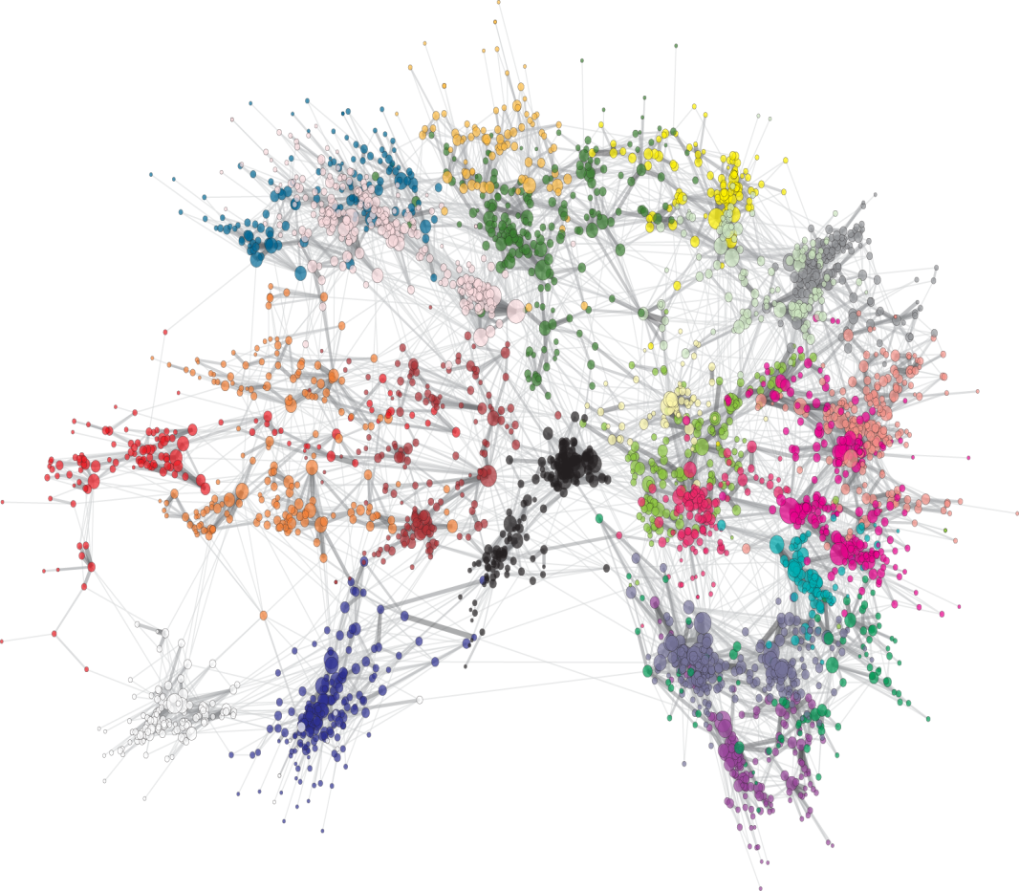
Basic Layout Heuristics
Network visualization helps build intuition, but you have to keep the drawing heuristic. Here we show the same graphs with two different techniques:
Fixed Coordinate Layouts
Fit: 0.528
Fit: .682
Two layouts of the same network

Slide 41
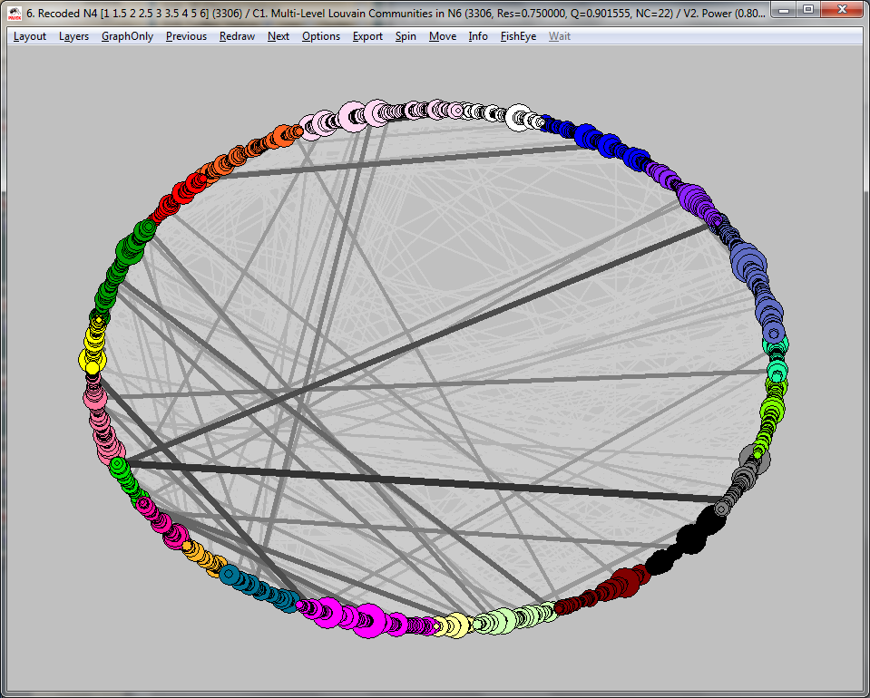
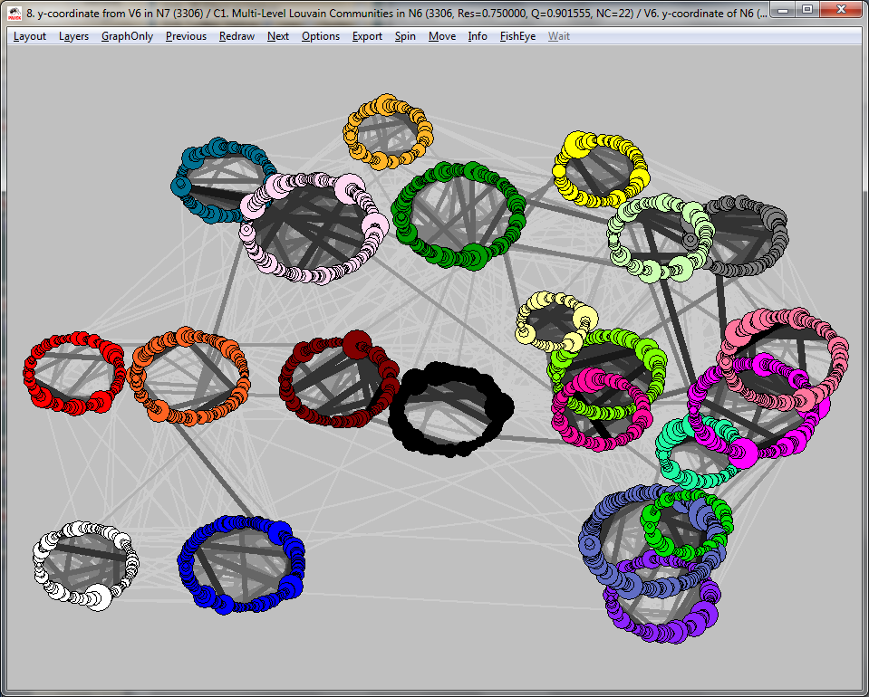
Basic Layout Heuristics
Network visualization helps build intuition, but you have to keep the drawing heuristic. Here we show the same graphs with two different techniques:
Fixed Coordinate Layouts
Fit=0.26
Fit=0.57
Two layouts of the same network

Slide 42
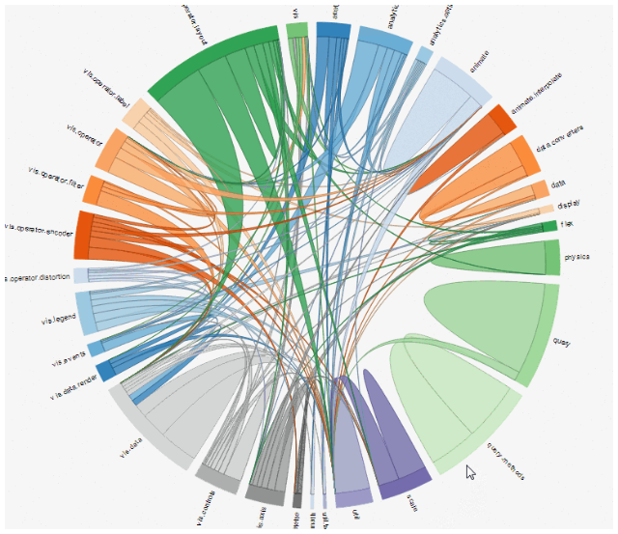
Basic Layout Heuristics
Fixed Coordinate Layouts
Chord diagrams are the network equivalent of pie charts
Fixed Coordinate Layouts
Two layouts of the same network

Slide 43
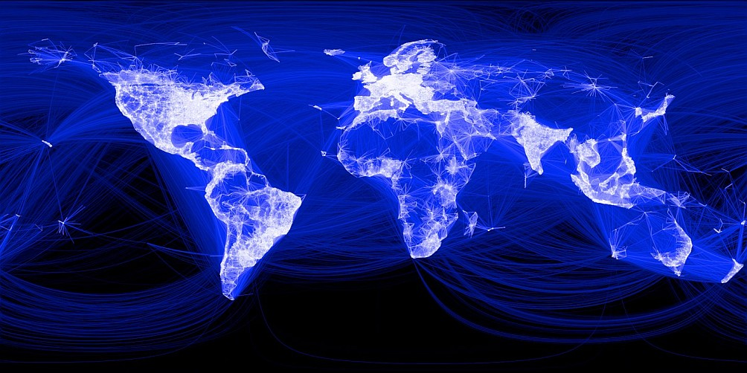
Basic Layout Heuristics
Use maps judiciously
Does this network map of Facebook tell us anything more than population density?

Slide 44
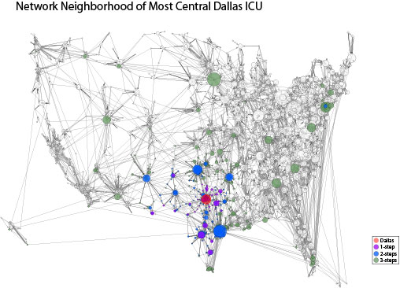
Basic Layout Heuristics
Use maps judiciously
Hear, goal was to show that network distance spanned vast geographic distance

Slide 45
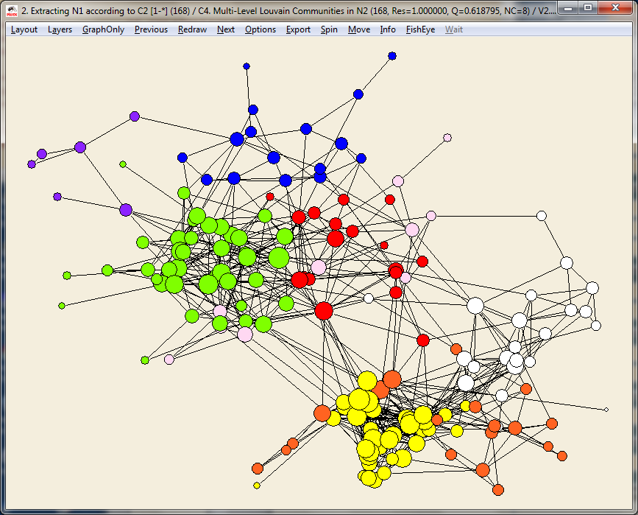

Basic Layout Heuristics
Levels of distortion?
Network visualization helps build intuition, but you have to keep the drawing heuristic. Here we show the same graphs with two different techniques:
Fit=0.81
Fit=0.75
Shrink each cluster to accent separation
Two layouts of the same network

Slide 46


Basic Layout Heuristics
Network visualization helps build intuition, but you have to keep the drawing heuristic. Here we show the same graphs with two different techniques:
Fit=0.81
Fit=0.74
Center fisheye on dense cluster

Slide 47


Secondary style elements
Some seemingly innocuous features can shape the effect of network diagrams
Use curves sparingly…they are usually useless – just extra ink – it’s a hallmark of the default Gephi style...and in Gephi is used to signal direction (out-ties curve to the left)…but else doesn’t add much.

Slide 48

Secondary style elements
Some seemingly innocuous features can shape the effect of network diagrams
3d is rarely useful…almost never in 2d presentations, sometimes interactively

Slide 49

Secondary style elements
Small multiples?
Based on work supported by R21-HD072810 (NICHD, Moody PI), R01 HD068523-01 (NICHD, Moody PI), R01 DA012831-05 (NIDA Morris, Martina PI),
Notes:
So we can define a space of potential degree distributions by two dimensions: volume & Variability

Slide 50



Network Diffusion & Peer Influence
A closer look at emerging connectivity
C:45%, B: 8.5%
Based on work supported by R21-HD072810 (NICHD, Moody PI), R01 HD068523-01 (NICHD, Moody PI), R01 DA012831-05 (NIDA Morris, Martina PI),
Notes:
So we can define a space of potential degree distributions by two dimensions: volume & Variability

Slide 51


Network Diffusion & Peer Influence
A closer look at emerging connectivity
C:83%, B: 36%
Based on work supported by R21-HD072810 (NICHD, Moody PI), R01 HD068523-01 (NICHD, Moody PI), R01 DA012831-05 (NIDA Morris, Martina PI),
Notes:
So we can define a space of potential degree distributions by two dimensions: volume & Variability

Slide 52


Network Diffusion & Peer Influence
A closer look at emerging connectivity
C:99%, B: 86%
Based on work supported by R21-HD072810 (NICHD, Moody PI), R01 HD068523-01 (NICHD, Moody PI), R01 DA012831-05 (NIDA Morris, Martina PI),

Slide 53
Secondary style elements
Some seemingly innocuous features can shape the effect of network diagrams
Use color & size to reinforce positional elements
Node shapes are almost impossible to discern

Slide 54
Static, Dynamic & Interactive
Lots of new tools for interactive network visualization. Consider:
http://bl.ocks.org/eyaler/10586116
Philosophy
https://kieranhealy.org/philcites/
Trump
https://graphcommons.com/graphs/ee4a43a2-3189-4f82-879c-960344332ea6

Slide 55

Static, Dynamic & Interactive
SVG: Fixed layout, but with embedded info
http://www.soc.duke.edu/~jmoody77/scimaps/DukePhdComm/comm2.htm

Slide 56

Static, Dynamic & Interactive
.js: Searchable
Export from Gephi using the js plugin
http://www.soc.duke.edu/~jmoody77/ChefNets/network/

Slide 57

Guiding Ideas:
Build theory into the visualization
The scientists first rule is to never interfere with data – but this is probably exactly what is needed for (social?) network science.
Consider as a good example, Ken Frank’s drawing program:
The “raw” network is distorted by emphasizing within-group ties. This is then highlighted by edge-patterns (solid or dotted) and group boundaries.
Group-weighted MDS
Notes:
The art analogy I have in mind is the contrast of, say, painting to music – music is creative within levels of constraint – defined by key, time signature, rule of harmony, etc. These can be violated, but the ability to pull that off is a skill – bad violations of harmony rules are amiturish, good ones are the mark of creativity.
The 3 featuers are actually 4, since “spread” and “space” are distinct.

Slide 58

Guiding Ideas:
Build theory into the visualization
The scientists first rule is to never interfere with data – but this is probably exactly what is needed for (social?) network science.
Or the dynamic visualizations of McFarland’s school classrooms.
Black ties: Teaching relevant communication
Blue ties: Positive social communications
Red ties: Negative social communication
Source: Moody, James, Daniel A. McFarland and Skye Bender-DeMoll (2005) "Dynamic Network Visualization: Methods for Meaning with Longitudinal Network Movies” American Journal of Sociology 110:1206-1241
Notes:
The art analogy I have in mind is the contrast of, say, painting to music – music is creative within levels of constraint – defined by key, time signature, rule of harmony, etc. These can be violated, but the ability to pull that off is a skill – bad violations of harmony rules are amiturish, good ones are the mark of creativity.
The 3 featuers are actually 4, since “spread” and “space” are distinct.
../papers/showtime/cls182kk.avi

Slide 59

Guiding Ideas:
Build theory into the visualization
The same data produce different impressions if you change the observation window.
Source: Bender-deMoll & McFarland “The Art and Science of Dynamic Network Visualization” JoSS 2006

Slide 60
Guiding Ideas:
Build theory into the visualization
The scientists second rule has to be to look for regularity and exploit that for theory. Consider as a good example, Harrison White’s Kinship model:
Notes:
The art analogy I have in mind is the contrast of, say, painting to music – music is creative within levels of constraint – defined by key, time signature, rule of harmony, etc. These can be violated, but the ability to pull that off is a skill – bad violations of harmony rules are amiturish, good ones are the mark of creativity.
The 3 featuers are actually 4, since “spread” and “space” are distinct.

Slide 61
Guiding Ideas:
Build theory into the visualization
The scientists second rule has to be to look for regularity and exploit that for theory. Consider as a good example, Harrison White’s Kinship model:
A powerful reduction of complexity; but at the cost of a particular perspective: Mom = Father’s Wife, for example.
Notes:
The art analogy I have in mind is the contrast of, say, painting to music – music is creative within levels of constraint – defined by key, time signature, rule of harmony, etc. These can be violated, but the ability to pull that off is a skill – bad violations of harmony rules are amiturish, good ones are the mark of creativity.
The 3 featuers are actually 4, since “spread” and “space” are distinct.

Slide 62

Basic Problem 1: Density/Scale
Abstraction helps – consider larger networks

Slide 63

Basic Problem 1: Density/Scale
Abstraction helps – consider larger networks

Slide 64

Basic Problem 1: Density/Scale
2009 Social Science Journal co-citation similarity

Slide 65

Basic Problem 1: Density/Scale
2009 Physical Science Journal co-citation similarity

Slide 66

Basic Problem 1: Density/Scale
Network Ecology Topic Map
Borrett, Stuart R., James Moody & Achim Edelmann. 2014. “The Rise of Network Ecology: Maps of the topic diversity and scientific collaboration” Ecological Modeling (DOI: 10.1016/j.ecolmodel.2014.02.019)

Slide 67

Static, Dynamic & Interactive
http://www.soc.duke.edu/~jmoody77/scimaps/DukePhdComm/comm2.htm

Slide 68

Basic Problem 1: Density/Scale
Abstraction helps – consider dense networks
Co-voting similarity, 109th senate

Slide 69

Basic Problem 1: Density/Scale
Abstraction helps – consider dense networks –
Co-voting similarity, 109th senate
See also: https://bost.ocks.org/mike/miserables/
Notes:
The art analogy I have in mind is the contrast of, say, painting to music – music is creative within levels of constraint – defined by key, time signature, rule of harmony, etc. These can be violated, but the ability to pull that off is a skill – bad violations of harmony rules are amiturish, good ones are the mark of creativity.
The 3 featuers are actually 4, since “spread” and “space” are distinct.

Slide 70

Basic Problem 2: Spread over a dynamic network
The traditional network diffusion image is the logistic curve. Consider Coleman, Katz and Menzel (1957):
These curves count the cumulative number of “adopters” by time, but don’t express much about network structure, because they aggregate across all transmissions.
That is, they show an aggregate outcome without really identifying a social process.

Slide 71

Basic Problem 2: Spread over a dynamic network
An alternative is to think of a network trace as the likely number reached from any given node, where “likely” is determined either by an edge transmission p(transfer|dist) or simple distance (geodesic), and follow each starting node.
Trace Curves: Number reachable at each step
The collection of curves is useful, to either compare to a null hypothesis or to contextualize an observed epidemic. Curves are simple to use, as we have good statistical measures of their shape.
But they are still one-step removed from the network itself, so how might we incorporate this information into the network?
Notes:
This can then be used to contextualize a particular node trace (such as the observed contact tracing from a first mover)

Slide 72

Basic Problem 2: Spread over a dynamic network
If your goal is to map an observed transmission process across a fixed network, node coloring can be effective.
But is hard when the graph is not simple.
How might we capture the relevant aspects of diffusion in a network of >10,000 nodes?
Source
Non-adopter
Notes:
This can then be used to contextualize a particular node trace (such as the observed contact tracing from a first mover)

Slide 73

Basic Problem 2: Spread over a dynamic network
Start with Context: Next a snapshot of a single day (limited to time-relevant)
Notes:
These are representations from a simulation; using a space-based layout algorithm for the cumulative graph, a degree-based layout for the one-day (since these are all disconnected little bits, put the larger bits in the middle). For the one-day slice, we only display nodes that are active on this given day and who are ultimately (if not yet) “downstream” of an infected node.

Slide 74

Basic Problem 2: Spread over a dynamic network
Start with Context: Now follow only the diffusion paths
Space-Based layout of the transmission flow; shows diffusion penetrates the full space, but little else…
Notes:
A key part of the story is that transmission is facilitated by concurrent edges, so we color the network edges by concurrency…

Slide 75

Basic Problem 2: Spread over a dynamic network
Start with Context: Now follow only the diffusion paths
Tree Based Layout.
Since concurrency is an edge property, we color the edges by the concurrency status of the tie…
Notes:
A key part of the story is that transmission is facilitated by concurrent edges, so we color the network edges by concurrency…

Slide 76

Basic Problem 2: Spread over a dynamic network
Start with Context: Now follow only the diffusion paths
Tree Based Layout.
..but since the path carries the infection, we highlight the cumulative effect of concurrency by noting any place where a transmission would have been impossible were it not for an earlier concurrent edge.
This is one way to deal with the importance of network dynamics.
Notes:
A key part of the story is that transmission is facilitated by concurrent edges, so we color the network edges by concurrency…

Slide 77

Basic Problem 2: Spread over a dynamic network
Start with Context: Now follow only the diffusion paths
An alternative version, here including non-transmission edges amongst the transmission set.
Notes:
A key part of the story is that transmission is facilitated by concurrent edges, so we color the network edges by concurrency…

Slide 78



Basic Problem 3: Display Dynamic Networks?
Dynamics complicate the standard point-and-line representation, since you cannot really follow all “possible” paths:
Notes:
A transition here: from following a single “bit” through time, to asking how dangerous a given network setting is. So now we want to ask how the structure affects likelihood of spread.

Slide 79

Basic Problem 3: Display Dynamic Networks?
Temporal projections of “net-time”
Time-Space graph representations
“Stack” a dynamic network in time, compiling all “node-time” and “edge-time” events (similar to an event-history compilation of individual level data).
Consider an example:
Repeat contemporary ties at each time observation, linked by relational edges as they happen.
Between time slices, link nodes to later selves “identity” edges

Slide 80

Example that combines many: Political Polarization
Consider again our senate voting network:
Network is simultaneously dense, (since every pair has some score) and dynamic, as the network evolves over time.

Slide 81

Example that combines many: Political Polarization
Consider again our senate voting network:
Network is dense, since every cell has some score and dynamic the pattern changes over time.

Slide 82

Political Polarization
Consider again our senate voting network:
Network is dense, since every cell has some score and dynamic the pattern changes over time.
One problem is that many nodes are structurally equivalent, generating “duplicate” information.

Slide 83

Political Polarization
Consider again our senate voting network:
Network is dense, since every cell has some score and dynamic the pattern changes over time.
Color by structural equivalence…

Slide 84

Political Polarization
Consider again our senate voting network:
Network is dense, since every cell has some score and dynamic the pattern changes over time.
Adjust position to collapse SE positions.
Notes:
Small Democrat Circle: Baucus, Harkin, Hollings, bumpers, Leahy, Dorgan, Reid, Wellstong, Feingold, Byrd.
Small Rep circle: Helms, Brown, Craig, Smith, Burns, Kempthorne, Thurmond, Stevens

Slide 85

Political Polarization
Consider again our senate voting network:
Network is dense, since every cell has some score and dynamic the pattern changes over time.
And then adjust color, line width, etc. for clarity.
While we’ve gone some distance with identifying relevant information from the mass, how do we account for time?
Notes:
Small Democrat Circle: Baucus, Harkin, Hollings, bumpers, Leahy, Dorgan, Reid, Wellstong, Feingold, Byrd.
Small Rep circle: Helms, Brown, Craig, Smith, Burns, Kempthorne, Thurmond, Stevens

Slide 86

Political Polarization
Consider again our senate voting network:
The extent of political polarization has been increasing recently:
Party polarization in Congress: a social networks approach, A. Waugh, L. Pei, J. H. Fowler, P. J. Mucha and M. A. Porter,
Notes:
Small Democrat Circle: Baucus, Harkin, Hollings, bumpers, Leahy, Dorgan, Reid, Wellstong, Feingold, Byrd.
Small Rep circle: Helms, Brown, Craig, Smith, Burns, Kempthorne, Thurmond, Stevens

Slide 87

Political Polarization
Movie is swamped by global density. So let’s combine a time-space projection with the block model.
Notes:
Small Democrat Circle: Baucus, Harkin, Hollings, bumpers, Leahy, Dorgan, Reid, Wellstong, Feingold, Byrd.
Small Rep circle: Helms, Brown, Craig, Smith, Burns, Kempthorne, Thurmond, Stevens

Slide 88

Political Polarization
Consider again our senate voting network:
← Polarization →
← Time →
Notes:
Small Democrat Circle: Baucus, Harkin, Hollings, bumpers, Leahy, Dorgan, Reid, Wellstong, Feingold, Byrd.
Small Rep circle: Helms, Brown, Craig, Smith, Burns, Kempthorne, Thurmond, Stevens

Slide 89

Political Polarization
Notes:
Small Democrat Circle: Baucus, Harkin, Hollings, bumpers, Leahy, Dorgan, Reid, Wellstong, Feingold, Byrd.
Small Rep circle: Helms, Brown, Craig, Smith, Burns, Kempthorne, Thurmond, Stevens

Slide 90
Conclusions: Developing a visual language of networks
The simplicity of Moreno’s sociograms was balanced against a determined consistency in presentation style that allowed one to compare across settings.
The aim of solid scientific visualization should be to (re-) develop such conventions.

Slide 91
Conclusions: Developing a visual language of networks
“Nouns” are the easy -- identifying symbols to represent known node/edge types should be easy to do.
Shape, color, size-for-magnitude and usually be made pretty intuitive.
The tradeoff is clutter; use shapes, in particularly, very sparingly.

Slide 92

Conclusions: Developing a visual language of networks
“Nouns” are the easy -- identifying symbols to represent known node/edge types should be easy to do.
Shape, color, size-for-magnitude and usually be made pretty intuitive.
The tradeoff is clutter; use shapes, in particularly, very sparingly.

Slide 93
Conclusions: Developing a visual language of networks
“Style” is always evident; we can (almost) as easily recognize the signature of a particular approach as one can the voice of an author.
This is both a characteristic of authors and the programs the use; but is typically done without reflection.
A review of elements suggests some simple features to examine for style.
For my eye, for example, most graphs use lines that are too thick and colors that are too harsh.

Slide 94
Communication Challenges in Network Visualization
Types of problems
So what distinguishes a scientifically effective visualization?
Basic quantitative visualization craft: (“style” or “rhetoric”)
Before
After

Slide 95
Conclusions: Developing a visual language of networks
The real challenge is to identify the active grammar underlying a language of networks. We’re looking for implied rules that link visual representations to social characteristics. For example: proximity-as-social-distance.
The key value of a grammar, is that dictionaries (or “pattern books”) collapse under the weight of observed diversity, while grammars admit many new utterances.
The current body of graph-heuristics are a place to start for this grammar -- they provide aesthetic “parts of speech” – but not style.

Slide 96
Conclusions
We are not there yet, nor are we usually “at our best” – thoughtless application of canned package visualizations often create goopy messes that convey little substantive information.
The solution is thoughtful application of a well-honed graphical style – the classic elements laid out by Tufte over 20 years ago for statistical visualization –tailored to the theoretical challenges of networks.

